Slide 1

League of Legends match predictor Design and development of an application able to predict a team’s victory in a League of Legends game using data mining techniques and algorithms
Data Mining and Machine Learning
2020/2021
Davide Vigna

Slide 2

Summary
Introduction
Dataset Building
Pre-Processing
Data Mining
Evaluation of Results
Application

Slide 3
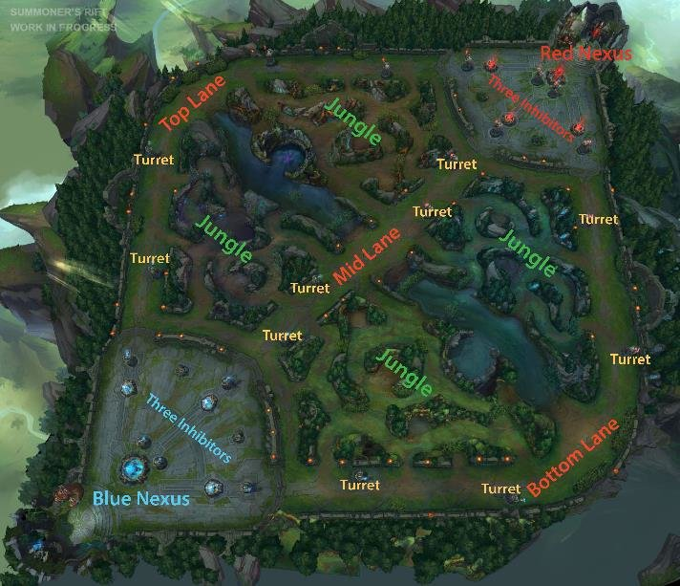
Introduction
What is League of Legends
Aim of this project
Binary Classification
Evaluate different data mining algorithms and select one for developing a web application

Slide 4
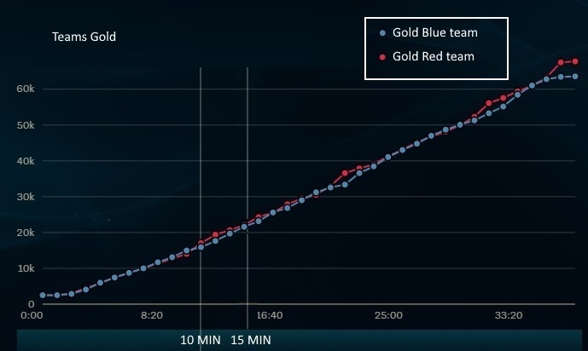
Dataset Building
Different and lots of data
Motivation
RIOT API
Scraping
Data Integration
Raw Data

Slide 5

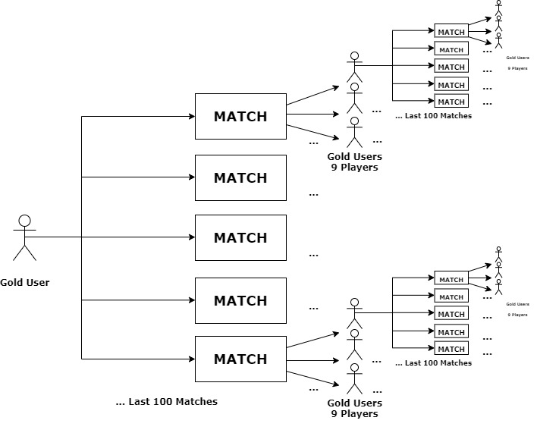
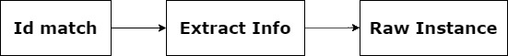
Dataset Building
Retrieving information about the match at minutes 10 and 15
Riot developer portal: technique of scraping
First Dataset: medium level games
Second Dataset: high level games
Found on the web
Filtered with the same process

Slide 6
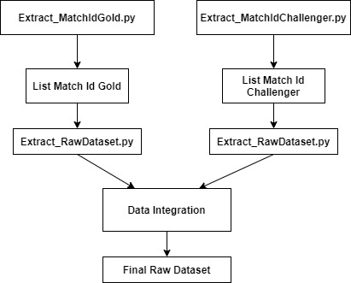
Dataset Building
Data Integration: no entity identification problem
Final Raw Dataset
51585 Instances
79 Attributes
Types: numerical-nominal
Bit imbalanced: rebalanced
Convention to identify Team-Minute-Attribute
E.g. BLUE_10Min_currentGold

Slide 7
Pre-Processing
Name | Type | Description
Win | Binary | 1 if a team has won the game at the end
Current_Gold | Numeric | the number of coins that a team can actually spend
Total_Gold | Numeric | the number of coins that a team have earned so far
Total_Level | Numeric | the sum of levels of each player in a team as far
TotMinionsKilled | Numeric | the number of minions killed from a team so far
TotJnglMinionsKilled | Numeric | the number of minions killed from a team so far, in the jungle area.
FirstKill | Binary | 1 if the team has done the first kill, 0 otherwise
Kills | Numeric | the total number of kills executing from a team so far
Deaths | Numeric | the total number of kills executing from a team so far
Assists | Numeric | the number of times a player in a team has participated in a kill
WardPlaced | Numeric | the total number of wards placed by a team so far
WardKilled | Numeric | the total number of enemy wards killed by a team so far
FirstTower | Binary | 1 if the team has destroyed the first tower, 0 otherwise
FirstInhibitor | Binary | 1 if the team has destroyed the first inhibitor, 0 otherwise
FirstTowerLane | Nominal | the line’s name in which the fist tower has been destroyed
TowerKills | Numeric | the total number of towers destroyed by the team so far
Inhibitors | Numeric | the total number of inhibitors destroyed by a team so far
FirstDragon | Binary | 1 if the team has killed the first dragon, 0 otherwise
Dragons | Numeric | the total number of dragons killed by the team so far
RiftHeralds | Numeric | the total number of rift heralds killed by the team so far
Course of dimensionality problem
Feature Extraction
Feature Construction
Feature Transformation
Feature Reduction
Raw Information for each team (BLUE-RED) for each minute (10-15)

Slide 8

Pre-Processing
Feature Extraction
Each numerical attribute can be seen in terms of difference
4 attributes are replaced by 1
E.g. attribute levels can be seen
$$DiffLevels=\left(RED_{15Min_{TotLevel}}− RED_{10Min_{TotLevel}}\right)−\left(BLUE_{15Min_{TotLevel}}−BLUE_{10Min_{TotLevel}}\right)$$

Slide 9

Pre-Processing
Feature Construction
Domination Ratio: how well team is playing
Ward Vision : how good is the team's vision in the map
Calculated for each minute (10 and 15)
Then applied feature extraction
$$DomRatio=\left\{\begin{aligned}&\begin{matrix}\frac{2∗Kills+Assists}{3∗Deaths} & if Deaths>0\end{matrix} \\ &\begin{matrix}2∗Kills+Assists & if Deaths=0\end{matrix}\end{aligned}\right.$$
$$WardVision_{TEAM_XXMIN}={( TEAM}_{XX{Min}_{wardPlaced}}−{TEAM_OPPONENT}_{XX{Min}_{wardDestroyed}})$$

Slide 10
Pre-Processing
Feature Transformation
Remapping of nominal attribute
E.g. FirstTower10 can assume { NONE, BLUE, RED }
E.g. BLUEFirstTowerLane can assume { NONE, BOT, MID, TOP}
All nominal attribute are transformed in numerical form
One Hot Encoding
Attribute | #Unique values
FirstKill | 2
FirstTower10 | 3
FirstTower15 | 3
FirstInhibitor | 3
FirstDragon10 | 3
FirstDragon15 | 3
BLUEFirstTowerLane | 4
REDFirstTowerLane | 4

Slide 11
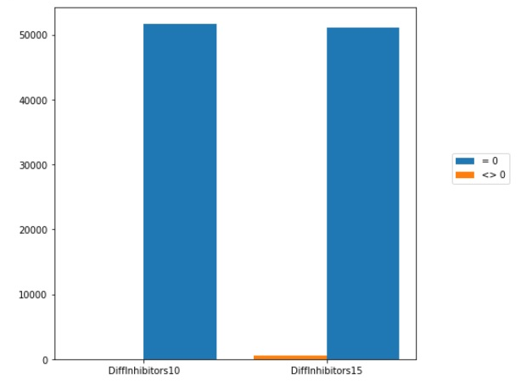
Pre-Processing
Feature Reduction
Removing irrelevant feature like
GameId
Team_Win (duplicated, 1 for team)
Removing redundant feature like
FirstKill10
FirstInhibitor10
DiffInhibitor10

Slide 12

Data Mining
Validation and Filtering
Random Forest
K-Nearest Neighbour
Naïve Bayesian
Support Vector Machine (SVM)
Linear Separation
Non-Linear Separation
Results

Slide 13
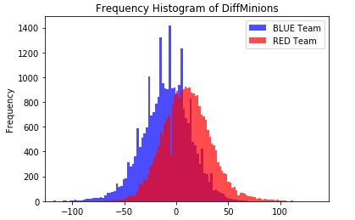
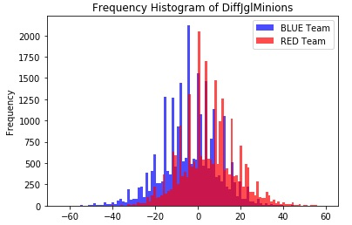
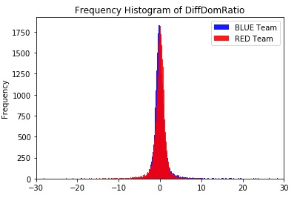
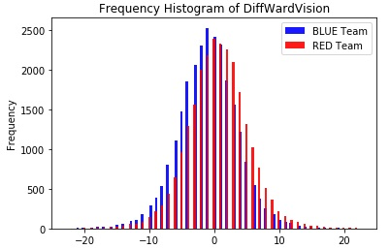
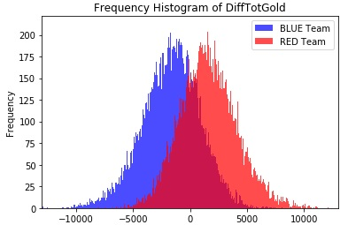
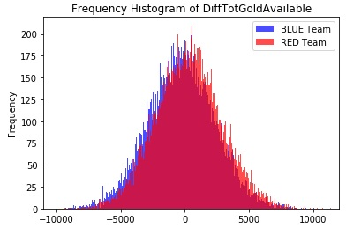
Data Mining
Validation
10-Fold-Cross-Validation
Filtering
Resampling: under sampling without replacement
Discretization
diffMinions, diffTotGold, diffDomRatio, diffJglMinions, diffWardVision, diffTotGoldAvailable
Normalization
Min-Max normalization in range [0,1]
Attribute Selection
Selecting the 10-Best Attributes ranked by chi2 metric
Hyperparameter tuning

Slide 14
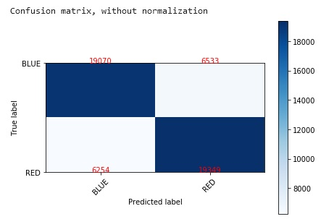
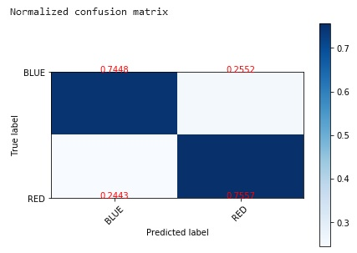
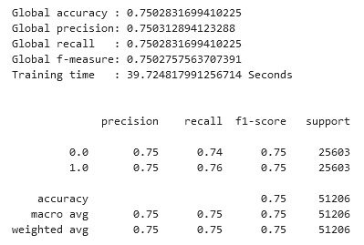
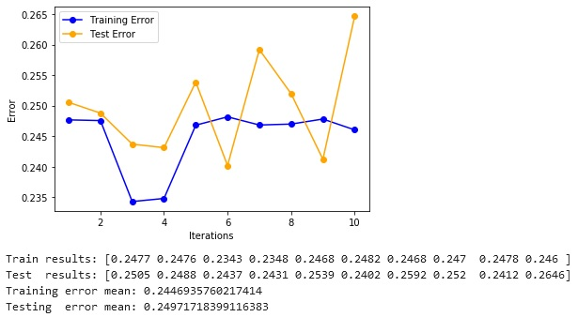
Data Mining
Random Forest
10 Estimators
Gini Index split metric

Slide 15
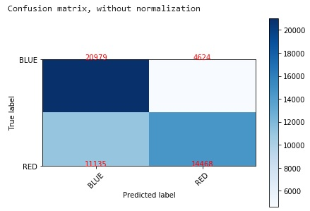
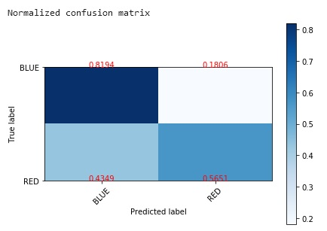
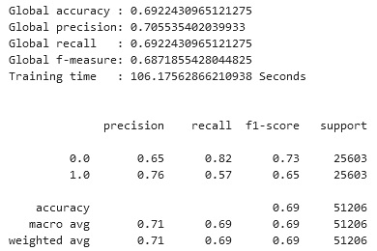
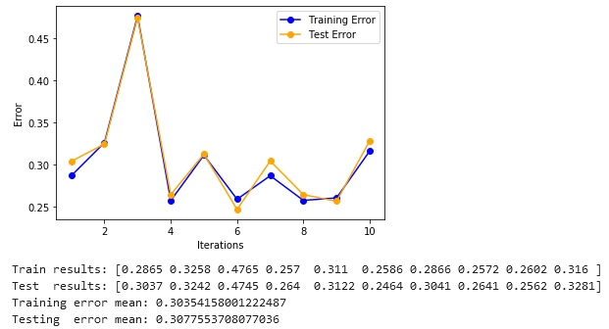
Data Mining
K-Nearest Neighbour
Choosing k=11

Slide 16
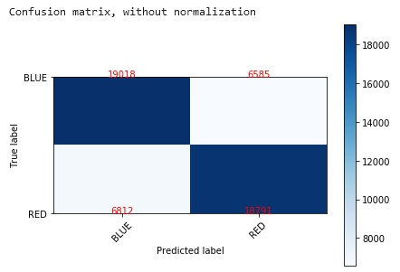
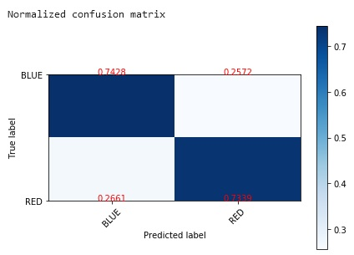
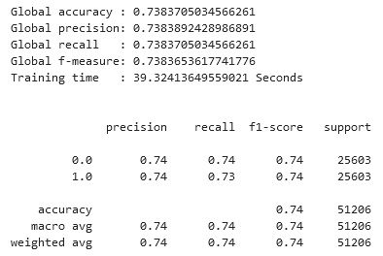
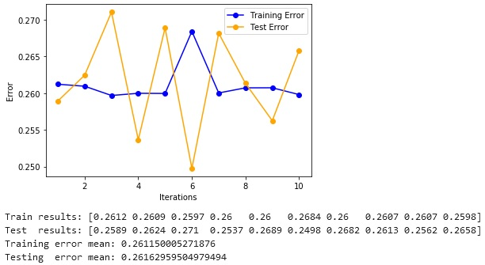
Data Mining
Naïve Bayesian
Assuming the likelihood of the features is gaussian

Slide 17
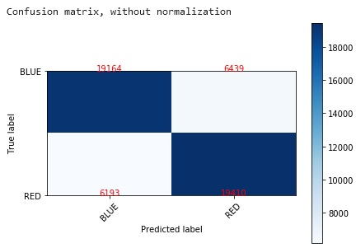
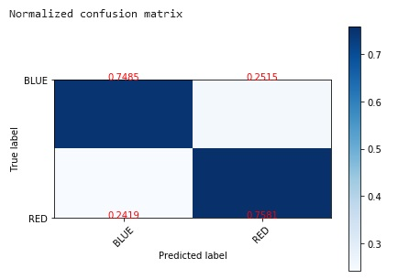
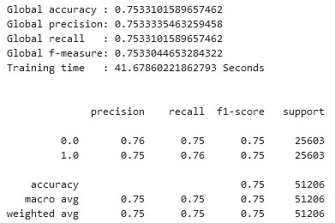
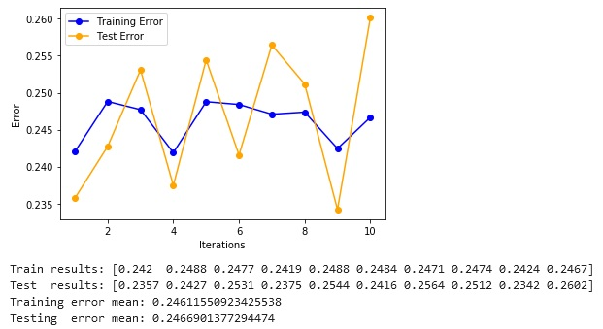
Data Mining
SVM – Linear Separation
Default parameters

Slide 18
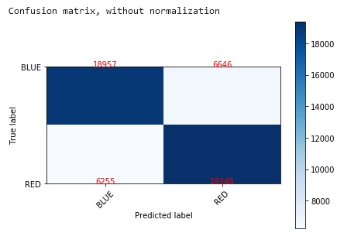
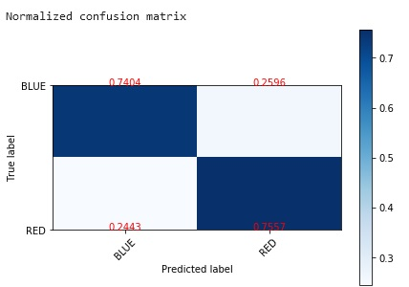
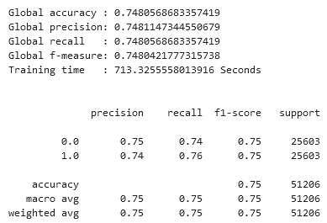
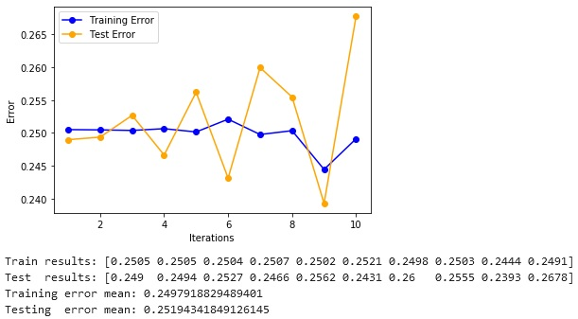
Data Mining
SVM - Non-Linear Separation
Polynomial Kernel

Slide 19
Data Mining
Results
Algorithm | Accuracy | Precision | Recall | F-Measure
SVM - Linear | 75,3310 % | 75,3333 % | 75,3310 % | 75,3304 %
Random Forest | 75,0283 % | 75,0312 % | 75,0283 % | 75,0283 %
SVM - Not Linear | 74,8056 % | 74,8147 % | 74,8056 % | 74,8042 %
Naïve Bayesian | 73,8370 % | 73,8389 % | 73,8370 % | 73,8365 %
KNN | 69,2243 % | 70,5535 % | 69,2243 % | 68,7185 %

Slide 20

Evaluation of Results
Observations
Model selection

Slide 21
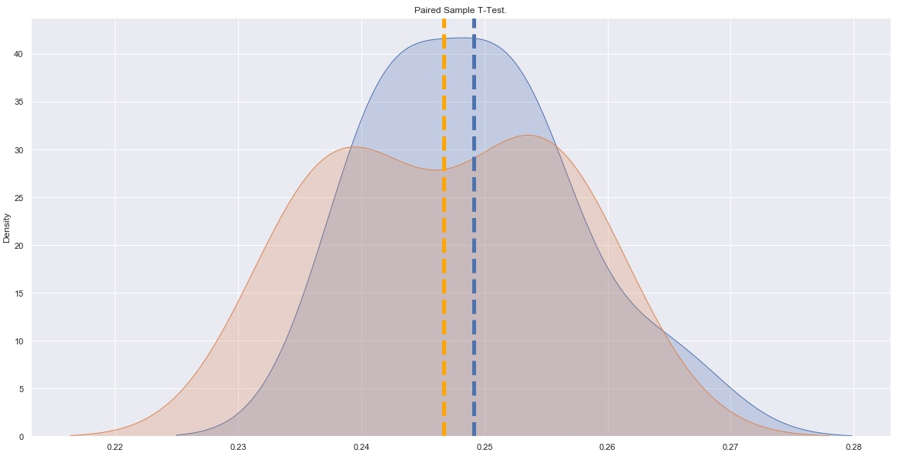
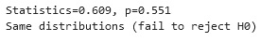
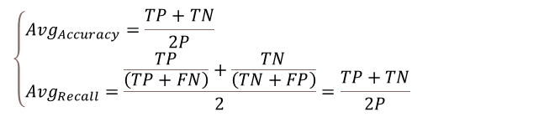
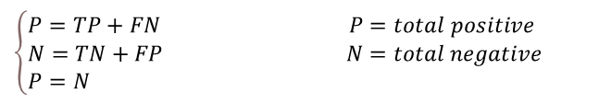
Evaluation of Results
Observations
The calculation of the ‘Recall’
Most of the models do not suffer too much the underfitting and the overfitting phenomena
KNN is the worst in terms of accuracy (bit underfitted)
Naïve Bayesian works very well but pay attention to attributes independent
SVM (Linear) and Random Forest obtained the highest score of accuracy and are quite similar in terms of execution time and overfitting score.
SVM (Not-Linear) requires lot of training time execution.
T-Test is executed on SVM (Linear) and Random Forest :
Null-hypothesis can’t be rejected: there is no statistical difference.
$$\left\{\begin{aligned}&P=TP+FN P=total positive \\ &N=TN+FP N=total negative \\ &P=N \end{aligned}\right.$$
$$\left\{\begin{aligned}&Avg_{Accuracy}=\frac{TP+TN}{2P} \\ &Avg_{Recall}=\frac{\frac{TP}{\left(TP+FN\right)}+\frac{TN}{\left(TN+FP\right)}}{2}=\frac{TP+TN}{2P}\end{aligned} \right.$$

Slide 22

Evaluation of Results
Model selection
SVM with linear separation
In general, for a two-class classification problem a SVM approach is more suitable to recognize data that tends to be linearly separated like in this project. Lower the number of dimension of the dataset better the separation will be.

Slide 23
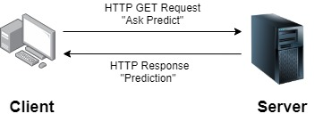
Application
Python web application: project structure
Interface and use

Slide 24
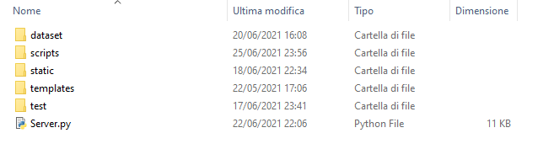
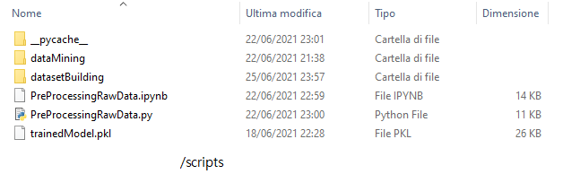
Application
Python web application: project structure

Slide 25
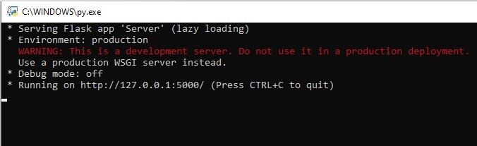
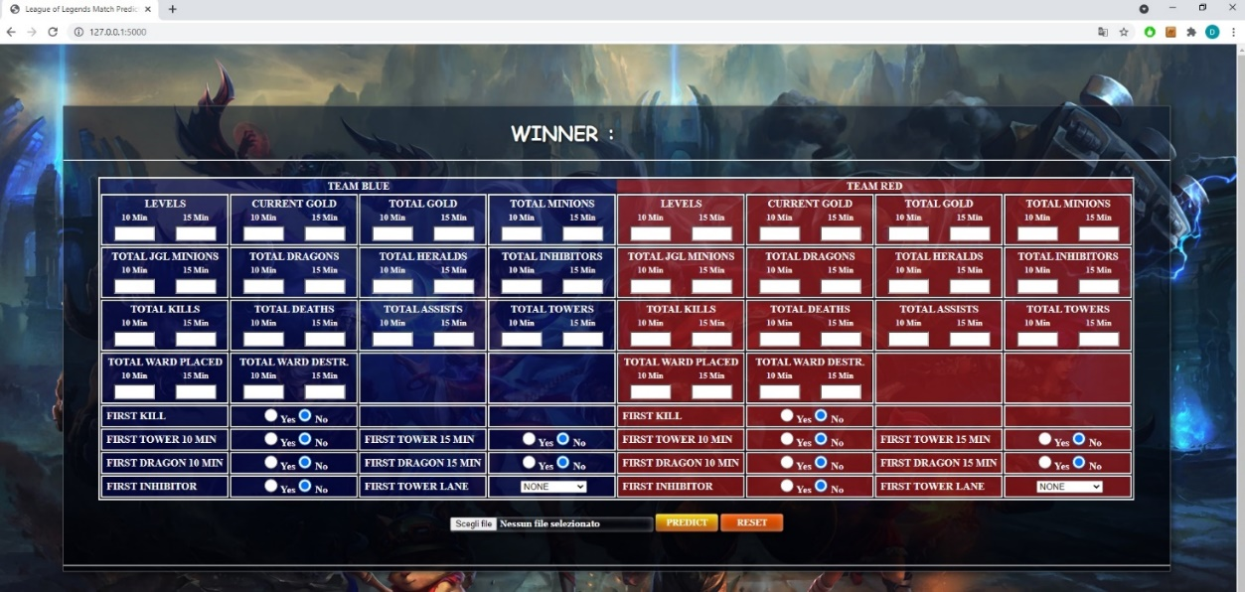
Application
Interface and use
Start the server
Open the browser
Type the server's address

Slide 26
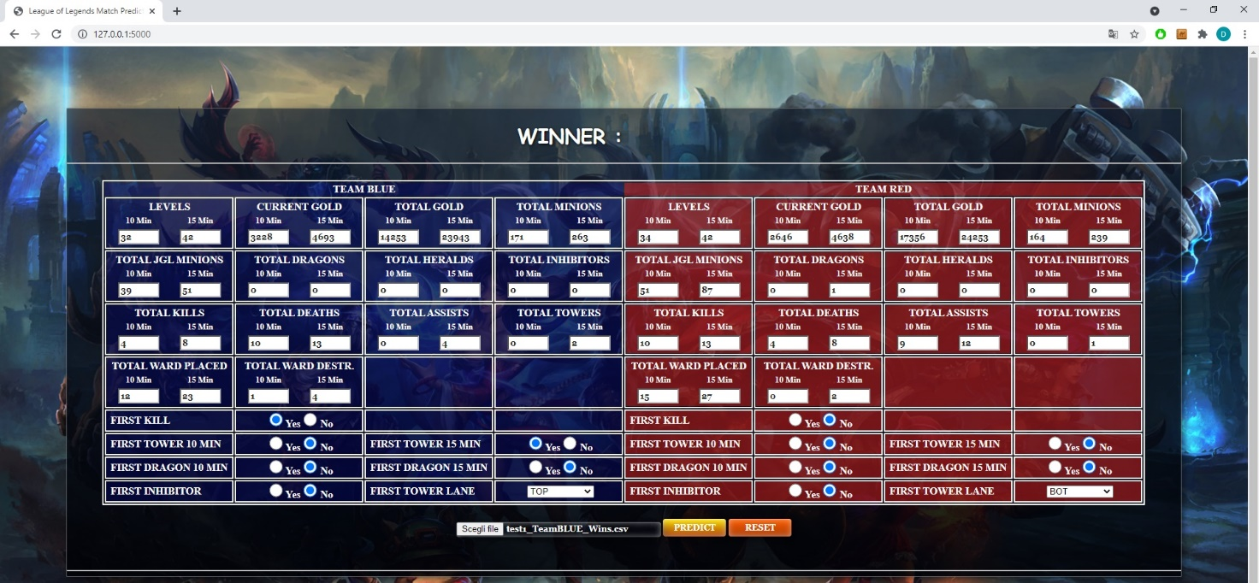
Application
Interface and use
Insert data manually or load a csv file

Slide 27
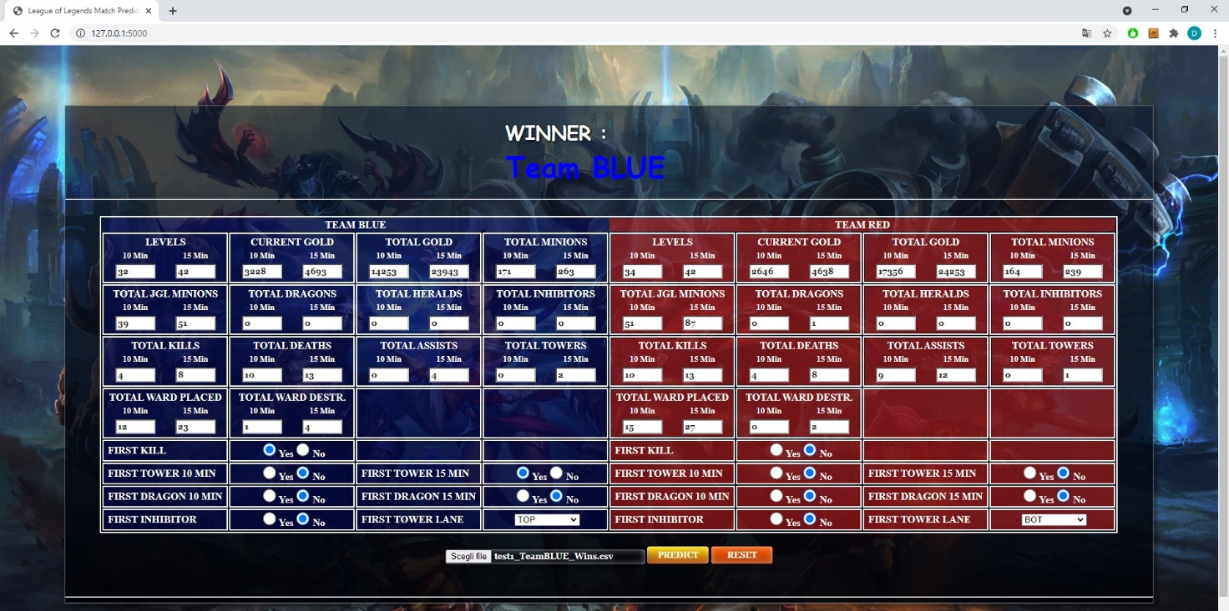
Application
Interface and use
Press button Predict to predict match winner
Press button Reset to clear all the fields

Slide 28
References
https://github.com/AlterVigna/League-of-Legends-match-predictor

